Slide 2

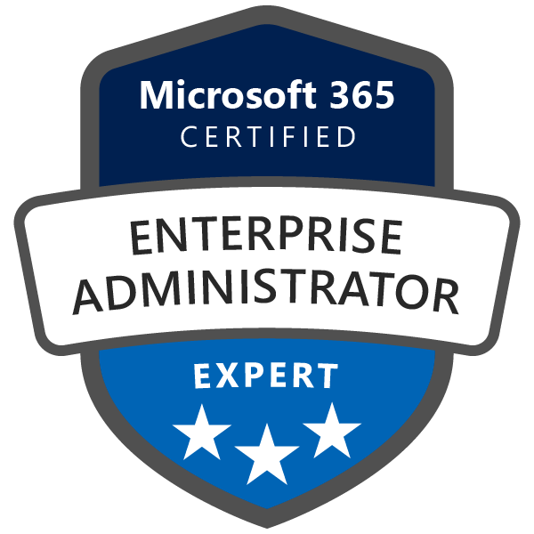

Microsoft Endpoint Manager What's new…
Ronni Pedersen
Microsoft MVP: Enterprise Mobility
rop@apento.com
+45 2085 9452

Slide 3
Paths to Modern Management
Cloud-only and Cloud-attached
Customers not using ConfigMgr
Directly to Cloud-Only (Intune)
Customers using Config Manager
Attach Config Manager and Intune
Customers using Config Manager
Cloud attach & provision all new devices as Cloud-Only
Deploy physical or virtual

Slide 4

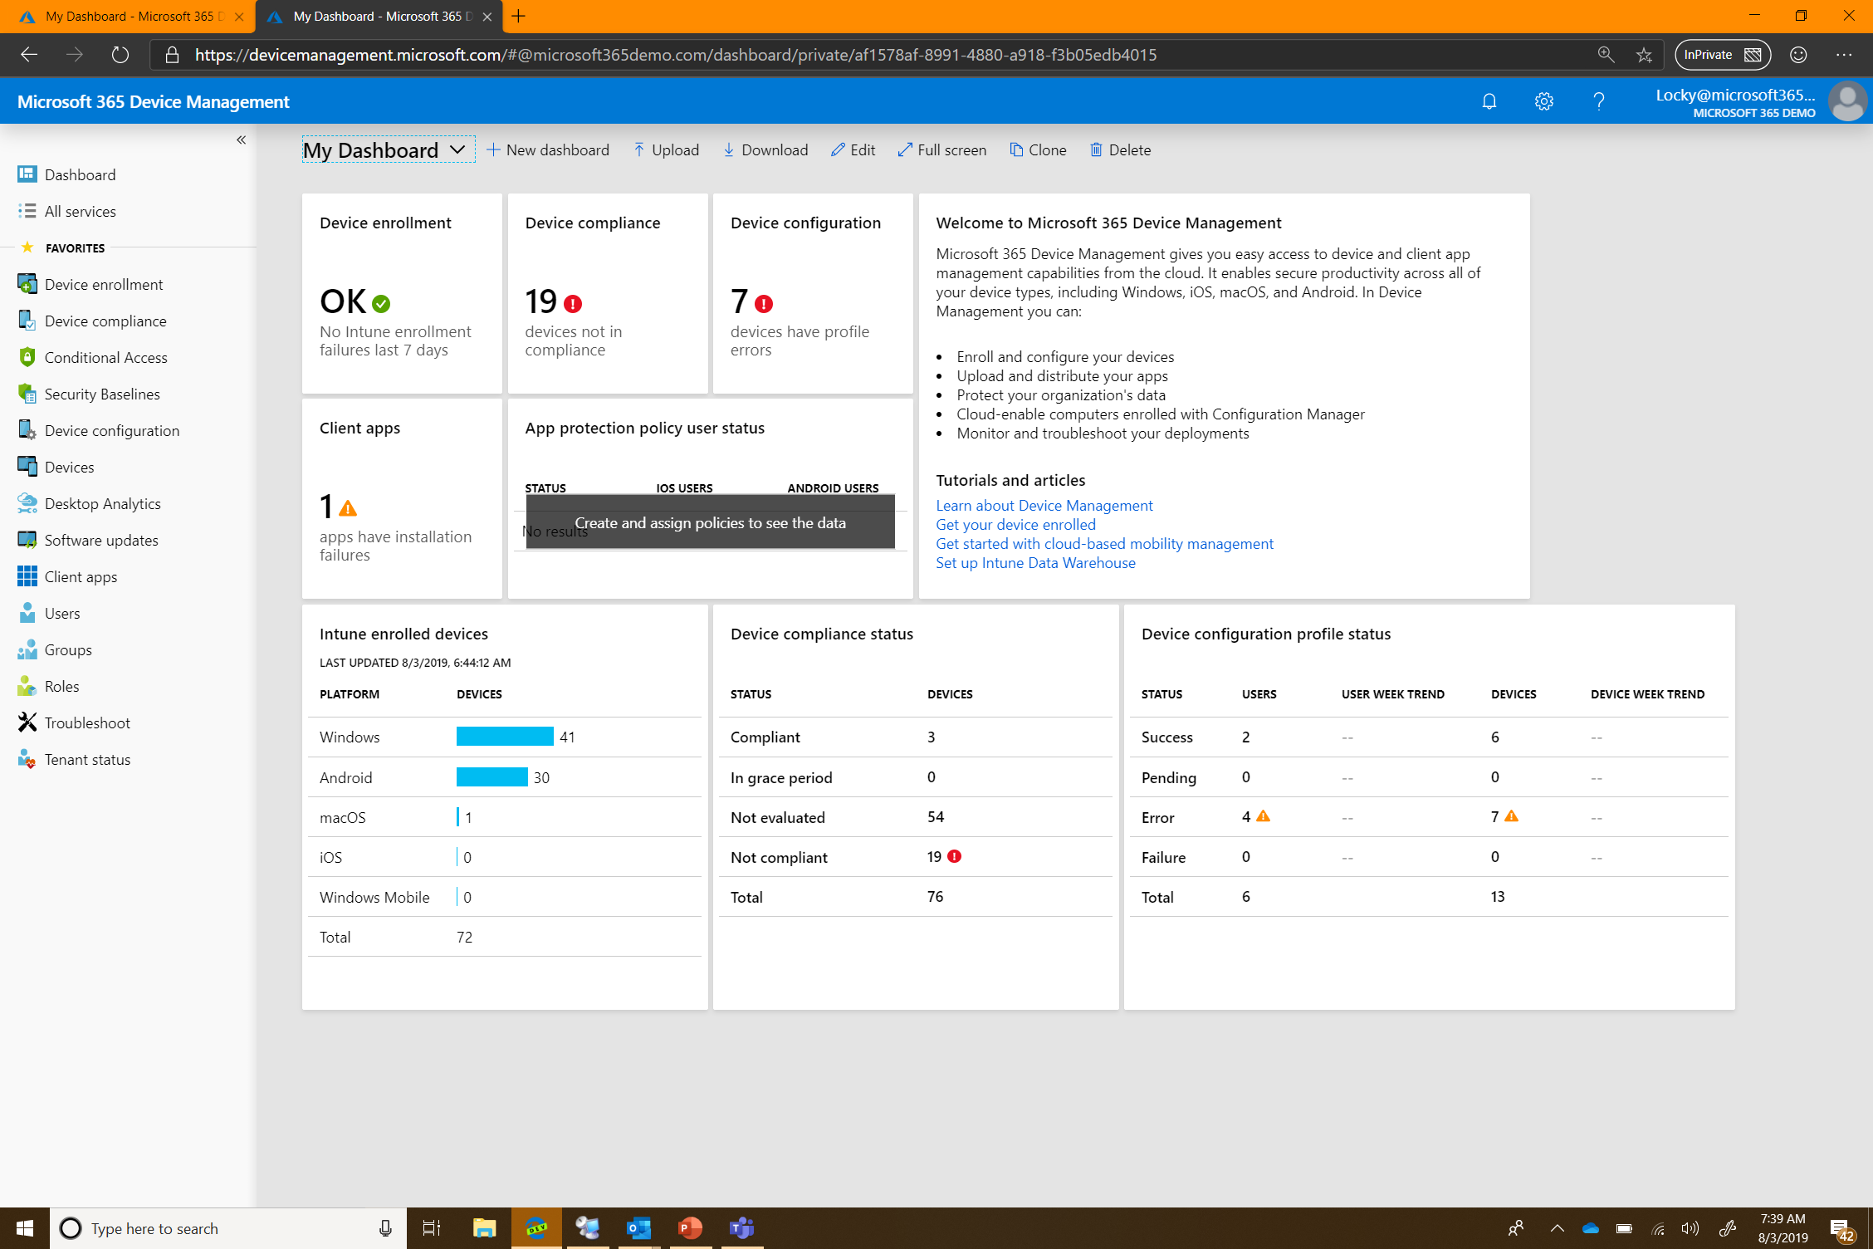
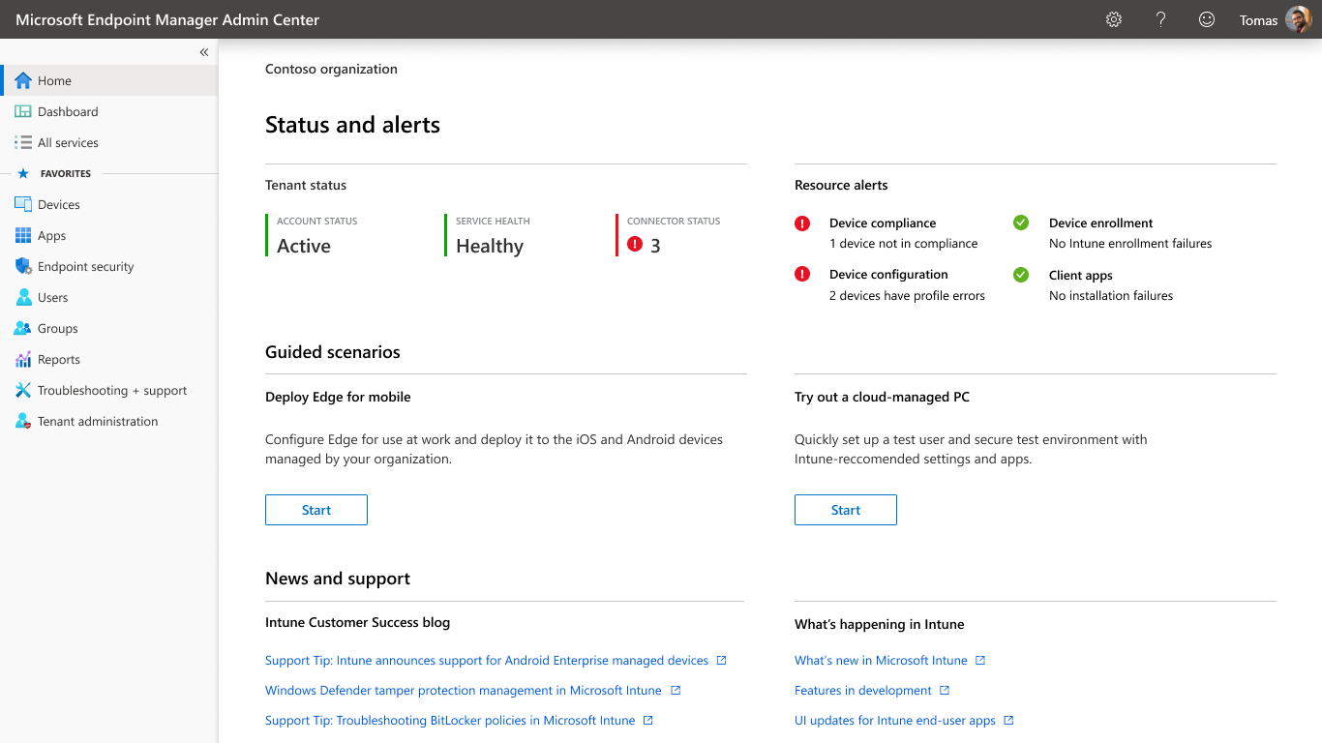
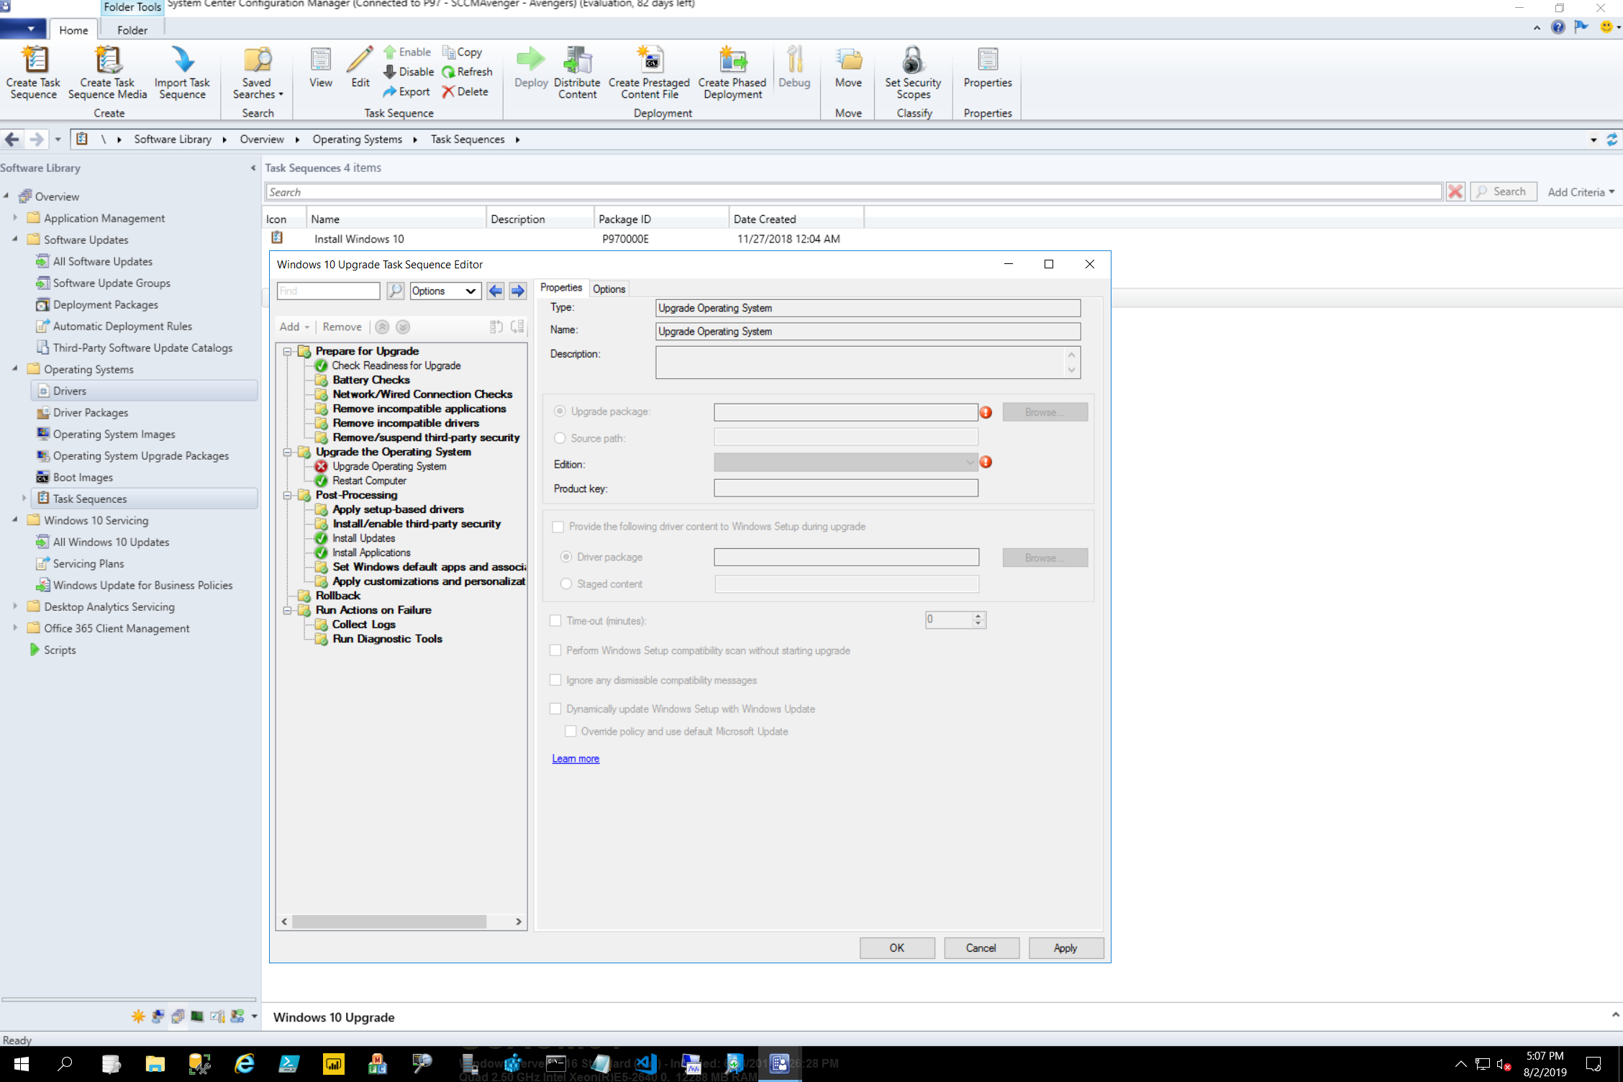
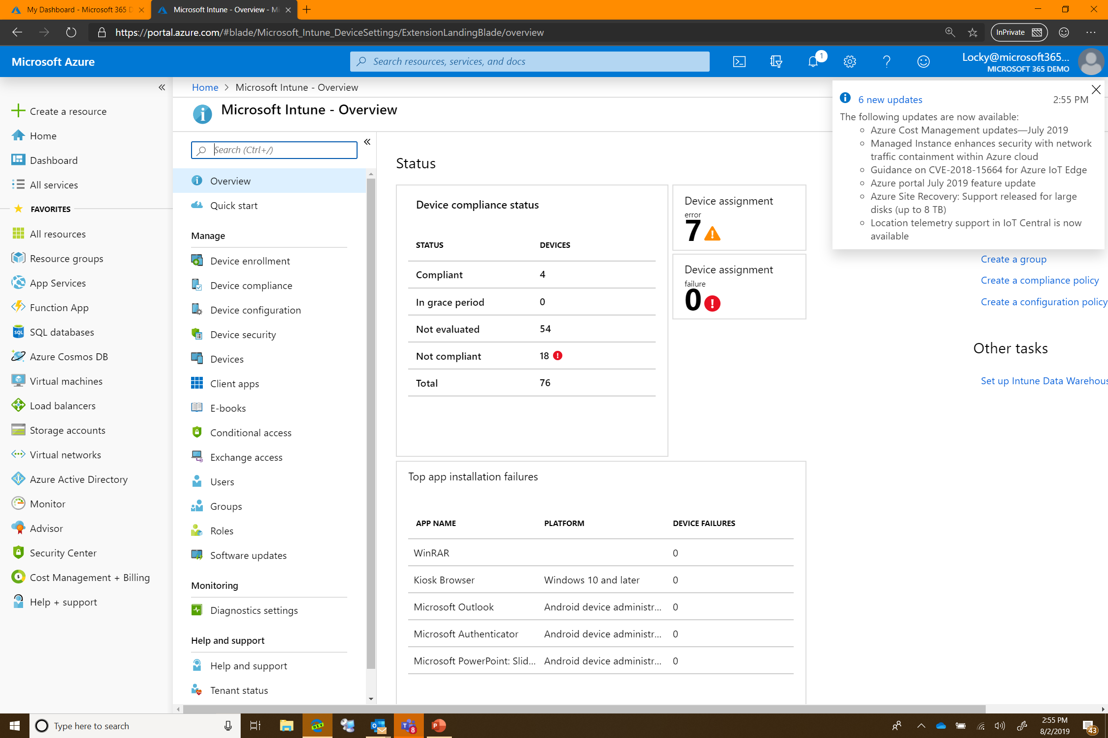
Microsoft Intune
Integrated solution for IT admins to understand and take action across all endpoints in their estate
Cloud infrastructure
Mobility Management
PC management
Security Admin
Microsoft Endpoint Manager
Configuration Manager
Intelligent edge for cloud infra
On premises infrastructure
PC Management
Other Endpoint Management Tools
Desktop Analytics
Autopilot
and more

Slide 5


Cloud powered endpoint management
OR
Config Mgr
Attached
Cloud
Only
Risk-based Control
Zero Touch Provisioning
Intelligent Security
Advanced
Analytics
Unified Management
Full stack integration
Endpoint Compliance and Risk
Conditional Access
App Protection Policy
Third party risk and compliance signaling
Windows Autopilot
Android Enterprise ZTD
Apple DEP
Samsung Knox Mobile Enrollment
Secure Score
Advanced Threat Protection
BitLocker management
Security Baselines
Windows Hello,
Attestation
Technology Experience Score
Desktop Analytics
Log Analytics
Real time advanced threat detection
Dynamic user risk assessment
Mobility and PC Management
M365 Admin Center
Guided Deployments
Office 365 Pro Plus
Edge
Role Based Admin
Graph API
PowerShell
Audit
Cloud content optimization

Slide 6
Announcing new co-management licensing
Mobility Management (iOS, Android, macOS) not included
When
December 1, 2019
How
Set up your AAD tenant (already done if you use Office 365)
Use Config Manager to enable Co-management
What
See your PCs in Microsoft Endpoint Manager
Cloud attach Config Manager PCs without an Intune license (co-managed)
Config Manager SA and AAD P1 required
Notes:
December… co-management

Slide 7
Cloud Attach
Microsoft Endpoint Manager Admin Center
DEP 40 - Thu 12:45pm
Supercharge PC and mobile device management: Attach Configuration Manager to Microsoft Intune and the Microsoft 365 cloud
Intune
Cloud intelligence drives management
Unified endpoint management
Web based admin for Config Manager
Config Manager

Slide 8
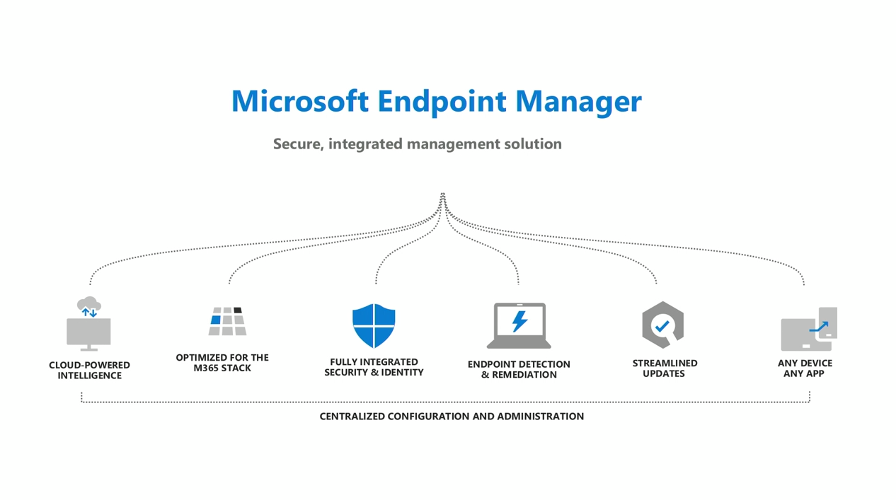

Slide 9
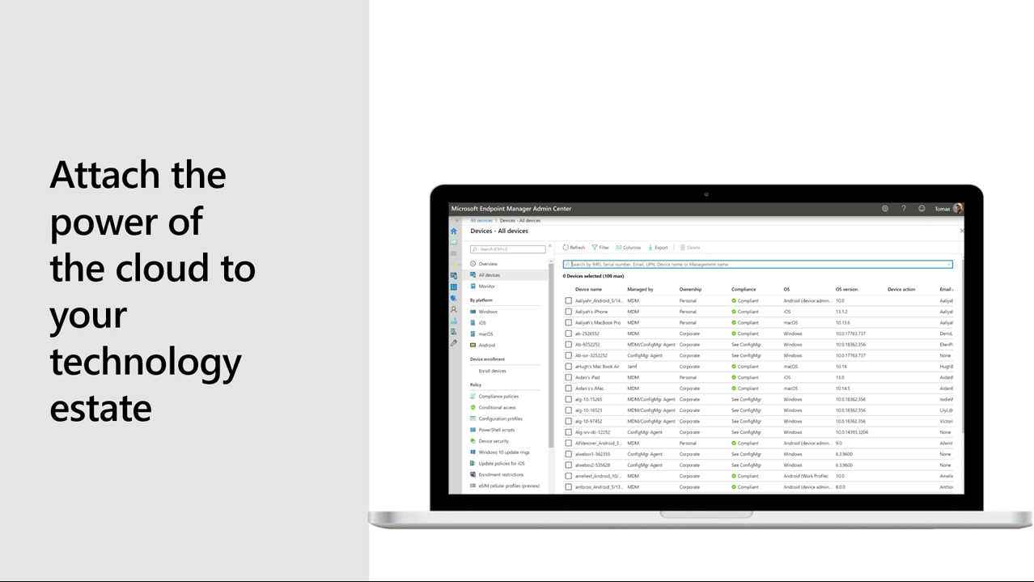

Slide 10
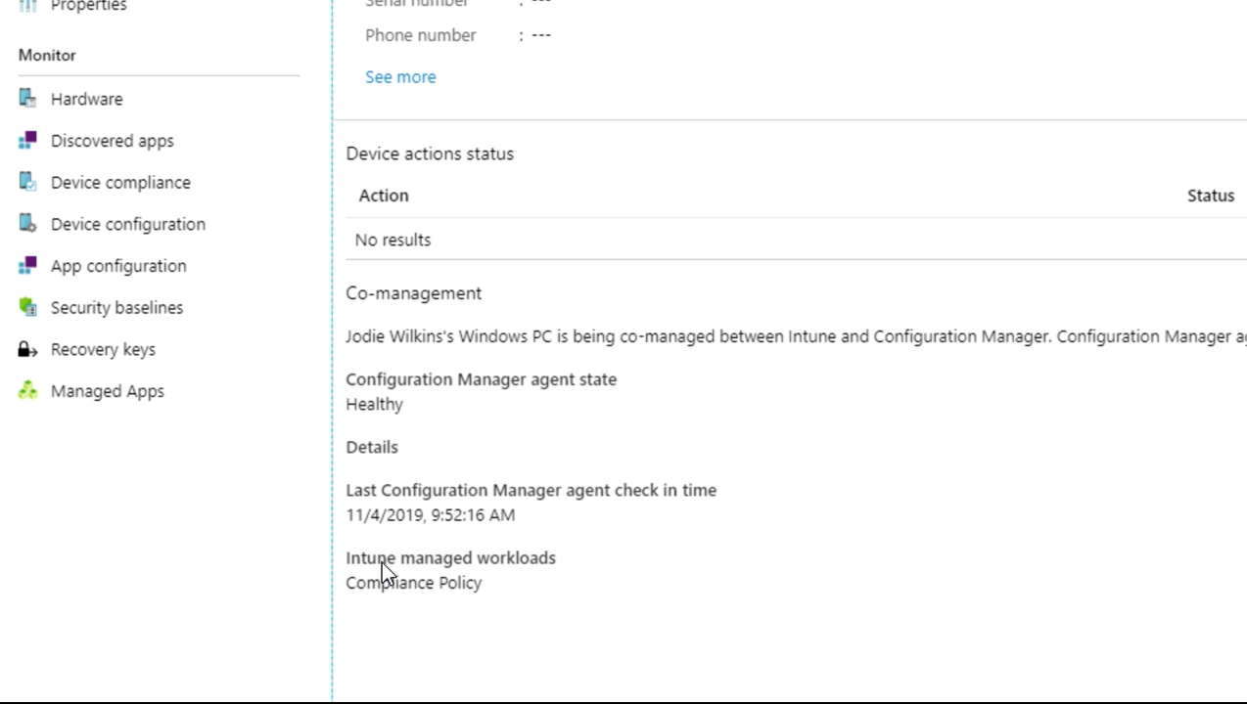

Slide 11
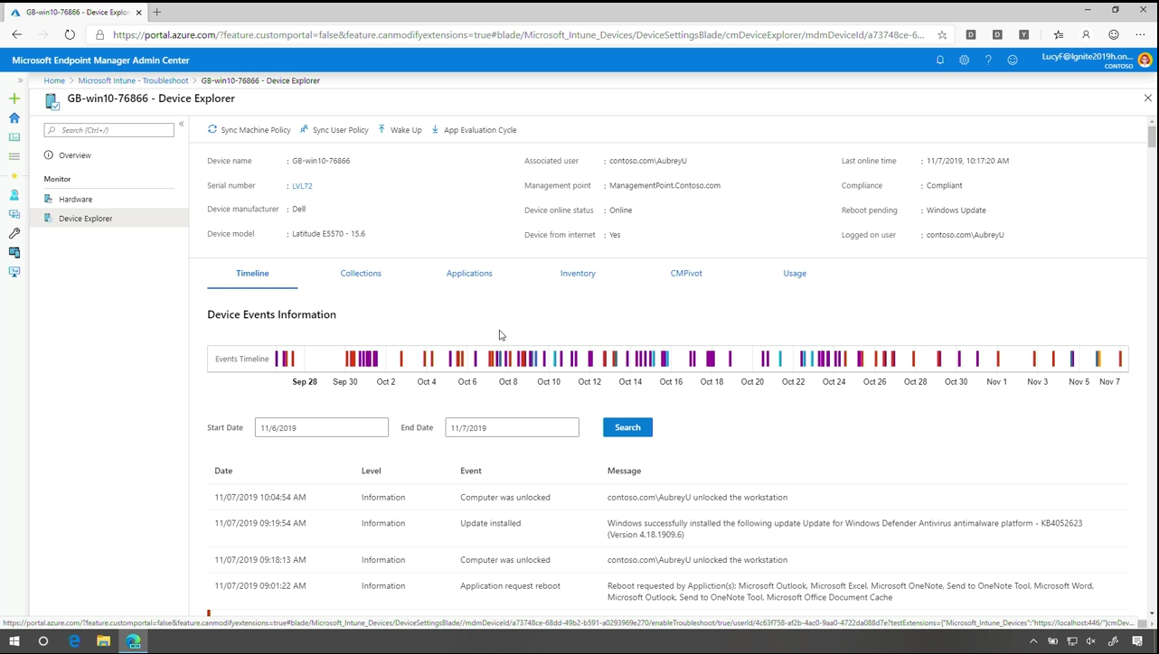
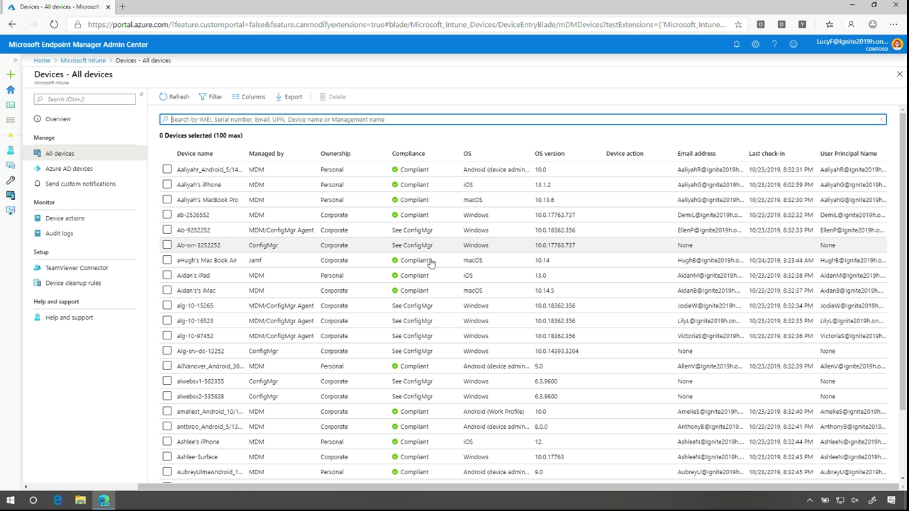
Notes:
Senario: Helpdesk
Dr. Watson database ☺

Slide 12
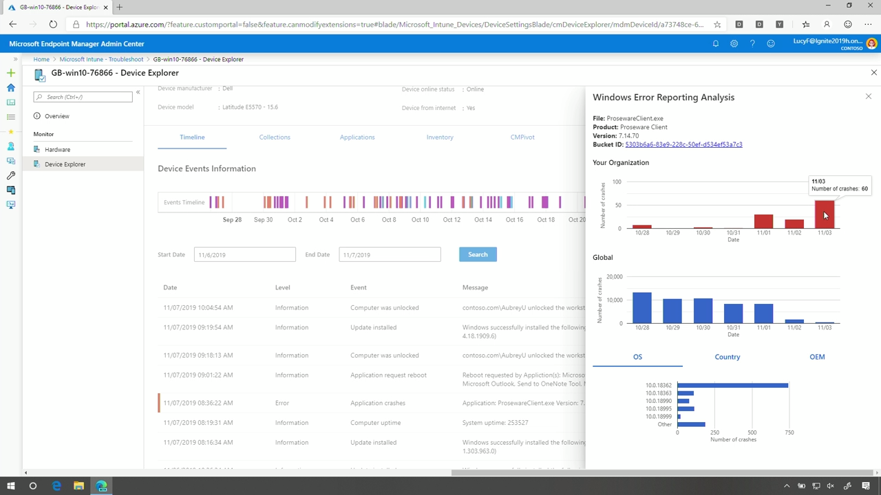

Slide 13
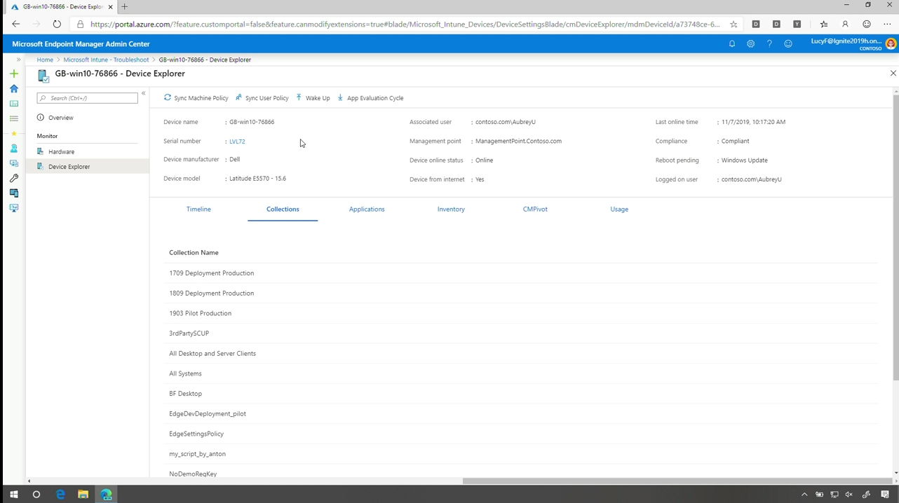

Slide 14
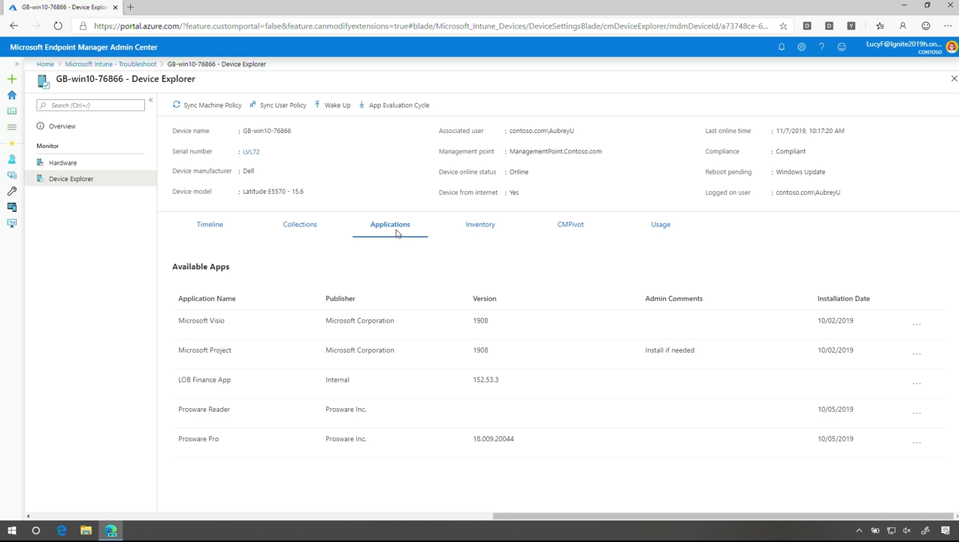

Slide 15
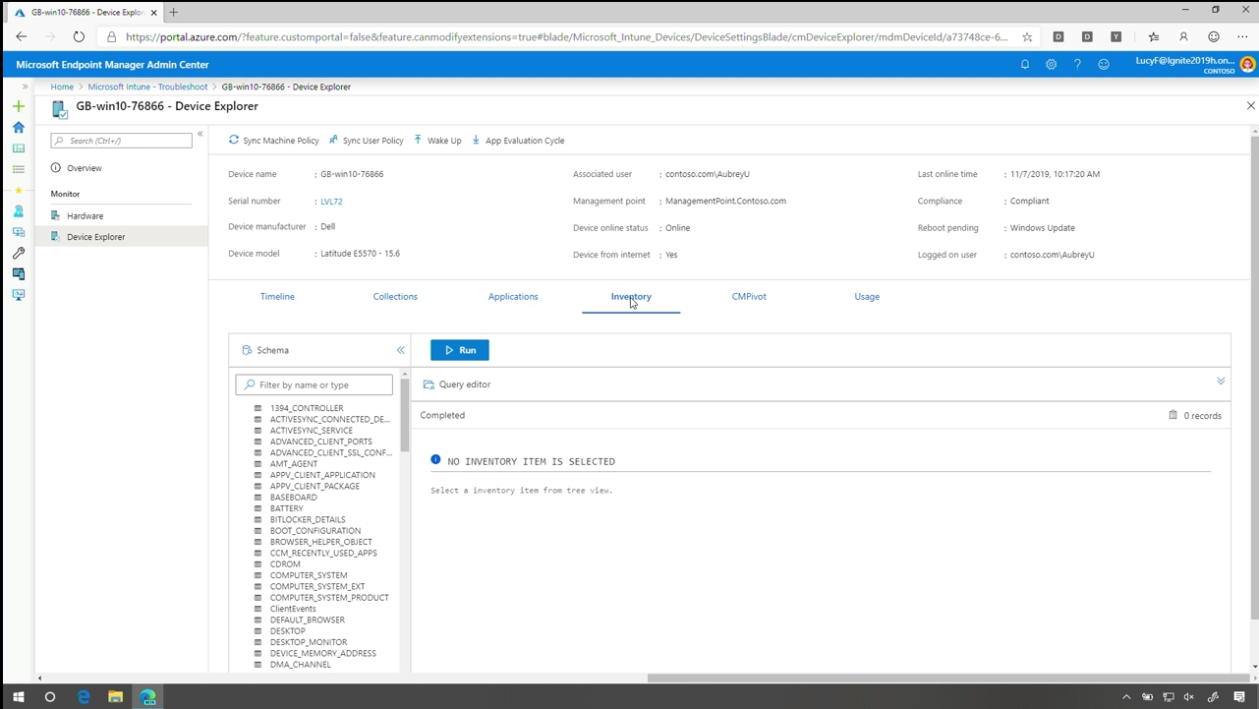
Notes:
Vil ikke sync hele databasen…
Hentes live fra SCCM….

Slide 16
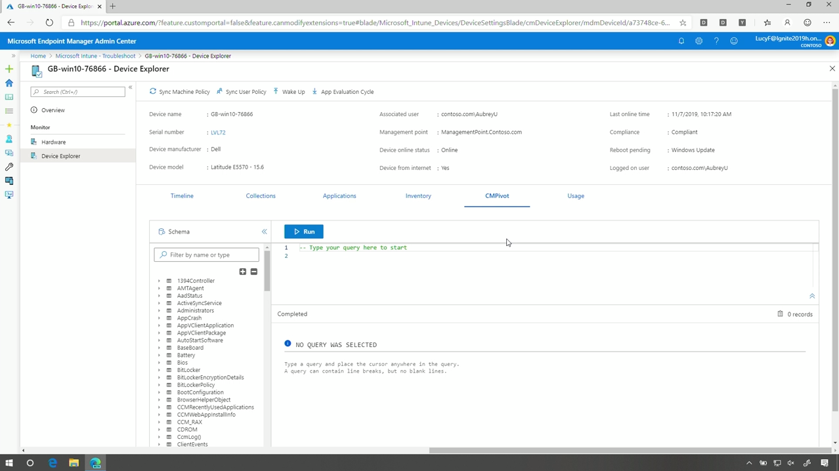
Notes:
Per device query
Realtime from client

Slide 17
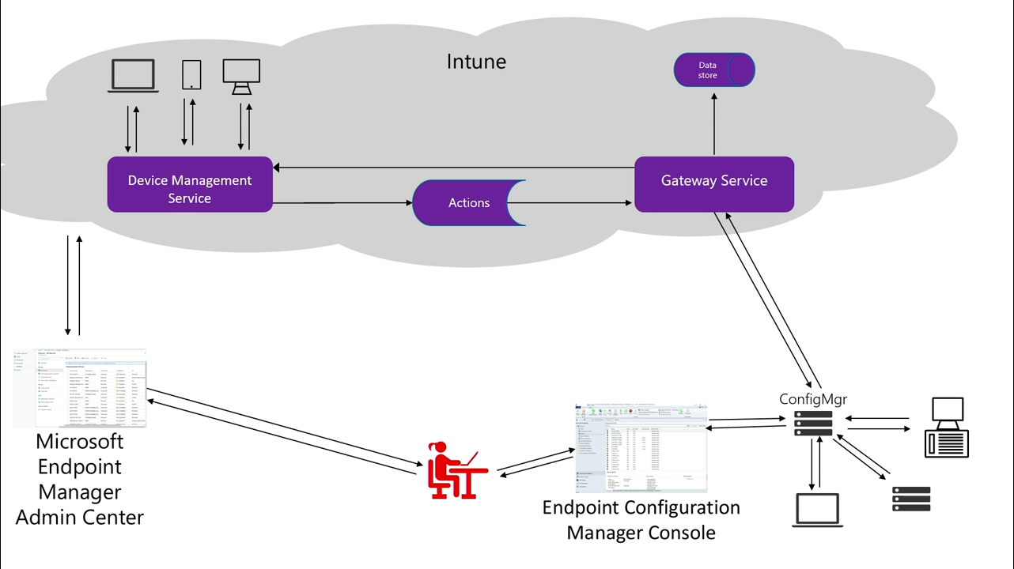
Notes:
The Archicture….

Slide 18
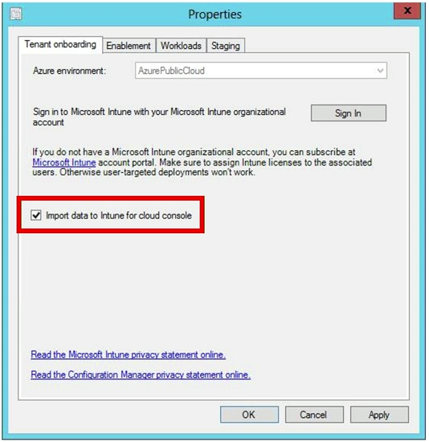
Enable Cloud Console

Slide 19
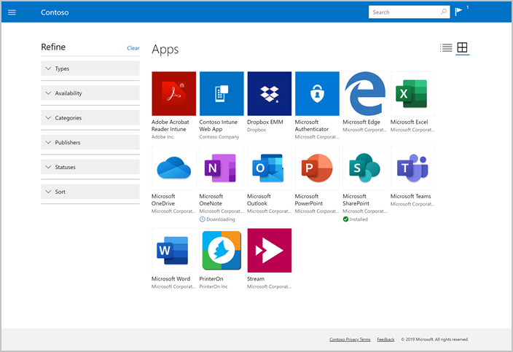
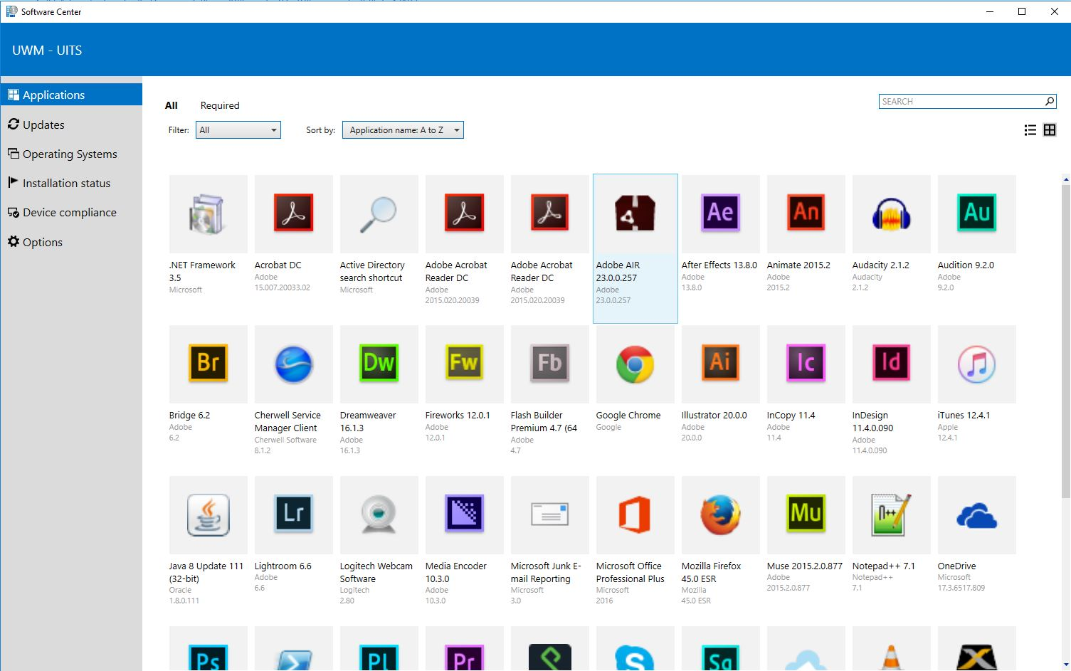
Portals

Slide 20
Autopilot
BRK 3077 - Tue 11:30 am
Windows Autopilot: What's new, what’s coming…
BRK 2362
Managing Surface UEFI BIOS settings with Microsoft Intune
Autopilot by
Microsoft Endpoint Manager
Device IDs
Incredible new device experience
Significant cost savings in OS deployment
Self-service deploy
Firmware management
Hardware Vendor
New hybrid identity support
Ship
Deliver direct to Employee
Employee unboxes device, self-deploys

Slide 21
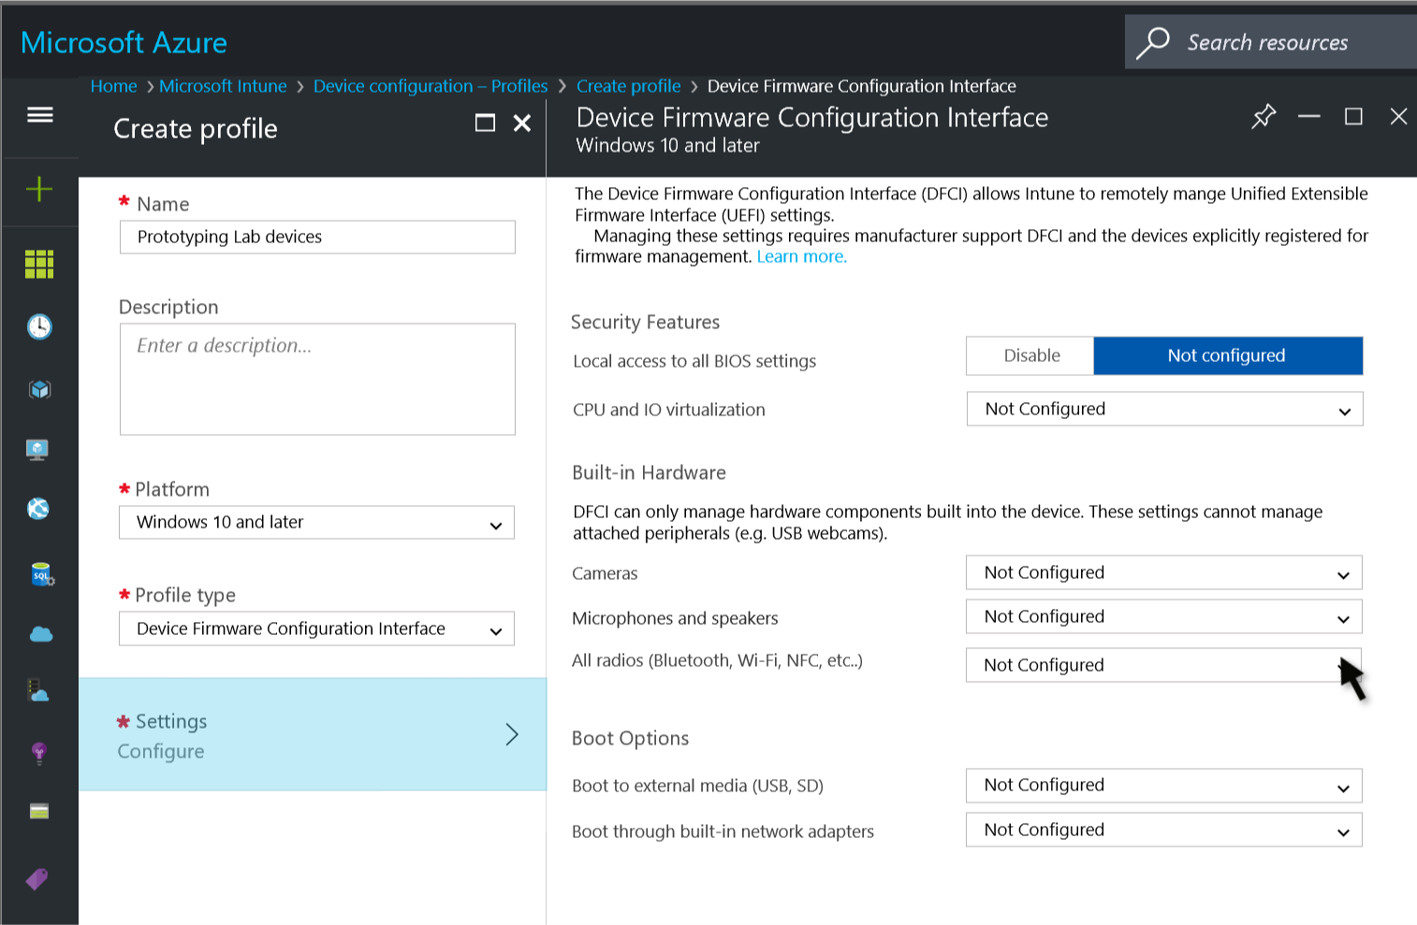
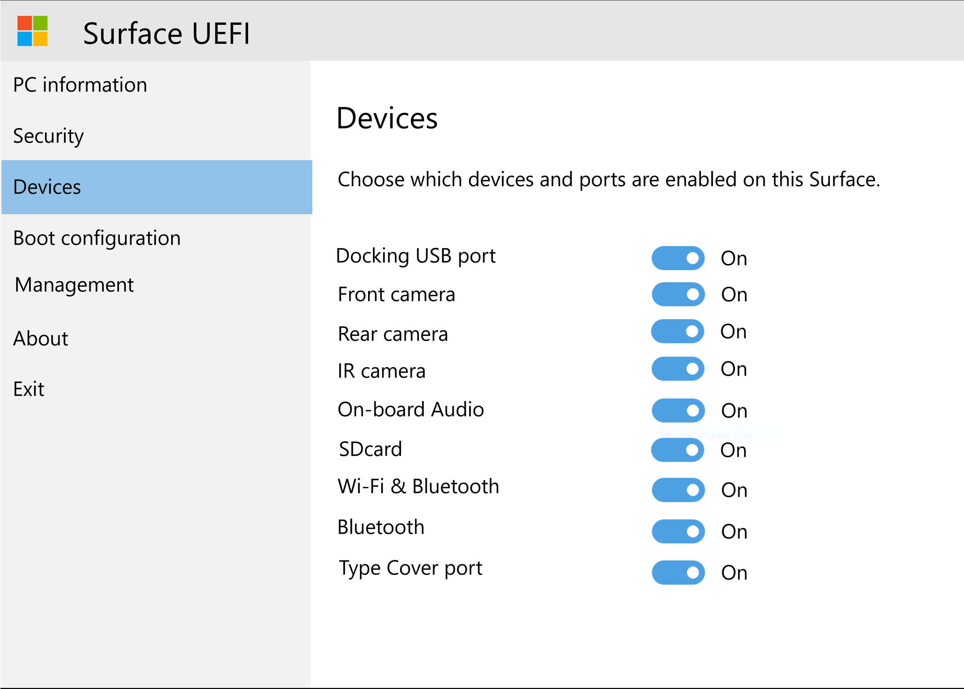
IT management of UEFI from the cloud
menu: Requires physical Touch
“password” is only authenticator
Zero-touch, Remote Management authorized via PKI
Notes:
Surface first… Men de arbejder med andre vendors!

Slide 22
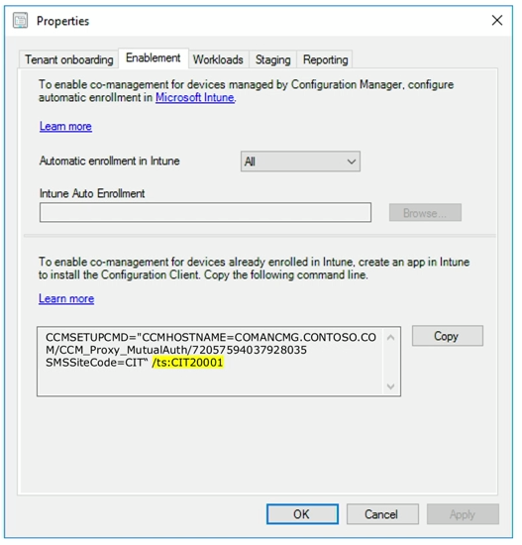
AutoPilot into a Task Sequence – comming soon

Slide 23

Experience Score
BRK 3086 - Tue 4:30 pm
Insights-driven device management: Use the power of analytics to optimize the user experience and enhance productivity
Signal
Increase productivity
Analytics by
Microsoft Endpoint Manager
IT Admin
Dramatically reduce helpdesk costs
Remediation
Quantify IT value to your organization
Provide the best employee experience

Slide 24
Desktop Analytics
Recommended software
Experience score
Remediation scripting
Startup performance

Slide 25
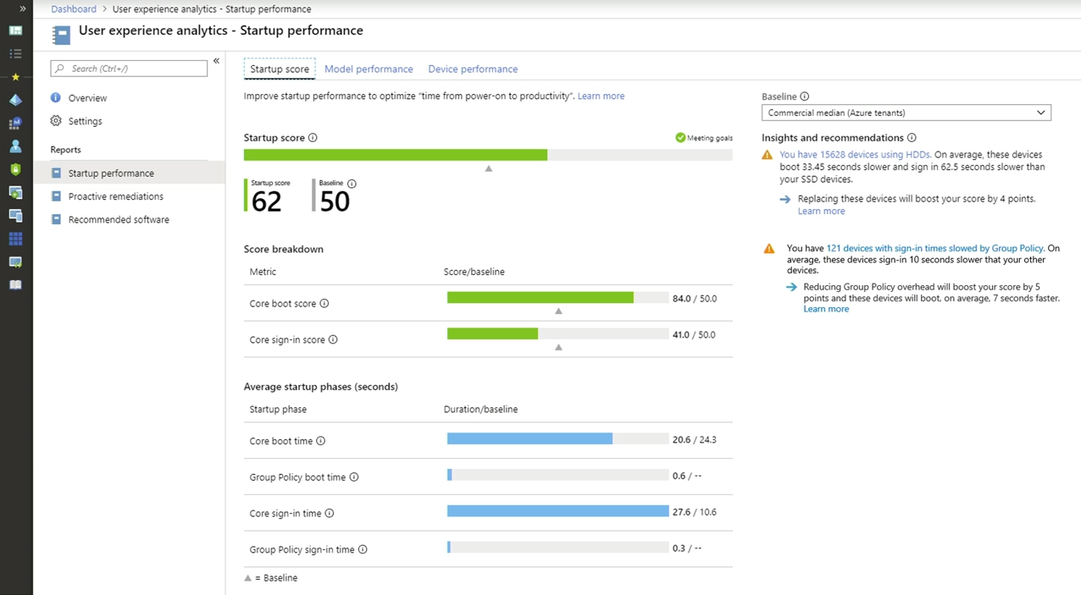

Slide 26
Experience Score within Microsoft
Pilot of 10k Devices (6k users) live since April 2019
Initial 2 remediations (Group policy & Office activation) yielded 29% ticket reduction (*adjusted)
Value of extensibility of the platform
Key insights into boot performance issues enabled targeted device refresh
Recommended Software gives insights into our AutoPilot program
* Overall ticket reduction adjusted by the organic reduction seen in the control group over the same period.

Slide 27
Cloud Content Optimization
M365
CDN
BRK 3078 - Tue 2:00 pm
Stay current while minimizing network traffic: the power of Delivery Optimization Edge Cache (DOINC)
Corporate Network
Intune PCs use SCCM Distribution Points
Config Manager Distribution Point
SCCM PCs get cloud content optimized
Microsoft Managed Cache
Simplified Distribution Point management
SCCM and Intune
Peer to peer caching

